Slide 1
MULTIMEDIA DATABASE SESI Image databasE (wajah)

Slide 2
Access by content (Konsep)
Attribut dinyatakan: sebagai sesuatu dalam ujud data (kodifikasi, biasanya alfanumerik) yang dinyatakan bagi object, dan tag tersebut tidak menyatakan apapun tentang karakteristik original object.
Attribut original hasil ekstraksi (visual attribut) : sebagai sesuatu dalam ujud data (kodifikasi, biasanya alfanumerik), yang ditentukan berdasarkan ekstraksi dari karakteristik original dari object. Pada kondisi ini, tag original dapat dikategorikan sebagai sesuatu yang merepresentasikan karakteristik original, meskipun belum tentu absolut valid, karena sudah melalui transformasi atau translasi (melalui ekstraksi).
Karaktetristik original: sesuatu deskripsi yang digunakan pada fenomena pengenalan object secara langsung.
Contoh: bagaimana dapat mengenali wajah secara langsung.

Slide 3
Question ?
What kinds of queries?
What kinds of databases?
What kind of constitutes a match?
How do make such access efficient?

Slide 4
What is a Multimedia DBMS?
A multimedia database management system (MM-DBMS) is a framework that manages different types of data potentially represented in a wide diversity of formats on a wide array of media sources.
Like the traditional DBMS, MM-DBMS should address requirements:
Integration
Data items do not need to be duplicated for different programs
Data independence
Separate the database and the management from the application programs
Concurrency control
allows concurrent transactions

Slide 5
Requirements of Multimedia DBMS
Persistence
Data objects can be saved and re-used by different transactions and program invocations
Privacy
Access and authorization control
Integrity control
Ensures database consistency between transactions
Recovery
Failures of transactions should not affect the persistent data storage
Query support
Allows easy querying of multimedia data

Slide 6
Requirements of Multimedia DBMS (cont.)
In addition, an MM-DBMS should:
have the ability to uniformly query data (media data, textual data) represented in different formats.
have the ability to simultaneously query different media sources and conduct classical database operations across them.
⇒ query support
have the ability to retrieve media objects from a local storage device in a smooth jitter-free (i.e. continuous) manner.
⇒ storage support
have the ability to take the answer generated by a query and develop a presentation of that answer in terms of audio-visual media.
have the ability to deliver this presentation in a way that satisfies various Quality of Service requirements.
⇒ presentation and delivery support

Slide 7
Major Issues: Query Support
Allow easy query of multimedia data
What is query by content?
Can query be specified as a combination of media (examples) and text description?
How to handle different MM objects?
What query language should be used?
Allow efficient query of multimedia data
What algorithms can be used to efficiently retrieve media data on the basis of similarity?
How should we index the content of different MM objects?
How to provide traditional DBMS supports?

Slide 8
Major Issues: Storage Support
How do the following (standard) storage devices work?
disk systems
CD-ROM systems
tape systems and tape libraries
How is data laid out on such devices?
How do we design disk/CD-ROM/tape servers so as to optimally satisfy different clients concurrently when these clients execute the following operations
playback
rewind
fast forward
pause

Slide 9
Major Issues: Presentation & Delivery Support
How do we specify the content of multimedia presentations?
How do we specify the form (temporal/spatial layout) of this content?
How do we create a presentation schedule that satisfies these temporal/spatial presentation requirements?
How can we deliver a multimedia presentation to users when there is
a need to interact with other remote servers to assemble the presentation (or parts of it)
a bound on the buffer, bandwidth, load, and other resources available on the system
a mismatch between the host server's capabilities and the customers machine capabilities?
How can such presentations optimize Quality of Service (QoS)?

Slide 10
A Sample Multimedia Scenario
Consider a police investigation of a large-scale drug operation. This investigation may generate the following types of data
Video data captured by surveillance cameras that record the activities taking place at various locations.
Audio data captured by legally authorized telephone wiretaps.
Image data consisting of still photographs taken by investigators.
Document data seized by the police when raiding one or more places.
Structured relational data containing background information, back records, etc., of the suspects involved.
Geographic information system data remaining geographic data relevant to the drug investigation being conducted.

Slide 11
Possible Queries
Image Query (by example):
Police officer Rocky has a photograph in front of him.
He wants to find the identity of the person in the picture.
Query: “Retrieve all images from the image library in which the person appearing in the (currently displayed) photograph appears”
Image Query (by keywords):
Police officer Rocky wants to examine pictures of “Big Spender”.
Query: "Retrieve all images from the image library in which “Big Spender” appears."

Slide 12
Possible Queries (cont.)
Video Query:
Police officer Rocky is examining a surveillance video of a particular person being fatally assaulted by an assailant. However, the assailant's face is occluded and image processing algorithms return very poor matches. Rocky thinks the assault was by someone known to the victim.
Query: “Find all video segments in which the victim of the assault appears.”
By examining the answer of the above query, Rocky hopes to find other people who have previously interacted with the victim.
Heterogeneous Multimedia Query:
Find all individuals who have been photographed with “Big Spender” and who have been convicted of attempted murder in South China and who have recently had electronic fund transfers made into their bank accounts from ABC Corp.

Slide 13
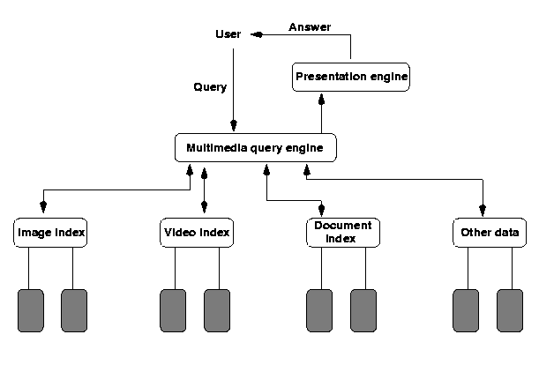
MM Database Architectures
Based on Principle of Autonomy
Each media type is organized in a media-specific manner suitable for that media type
Need to compute joins across
different data structures
Relatively fast query
processing due to
specialized structures
The only choice for legacy
data banks

Slide 14
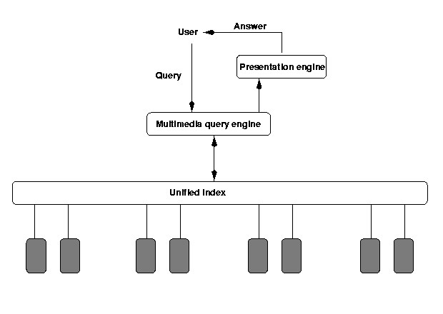
MM Database Architectures (cont.)
Based on Principle of Uniformity
A single abstract structure to index all media types
Abstract out the common part of different media types (difficult!) - metadata
One structure - easy implementation
Annotations for different
media types

Slide 15
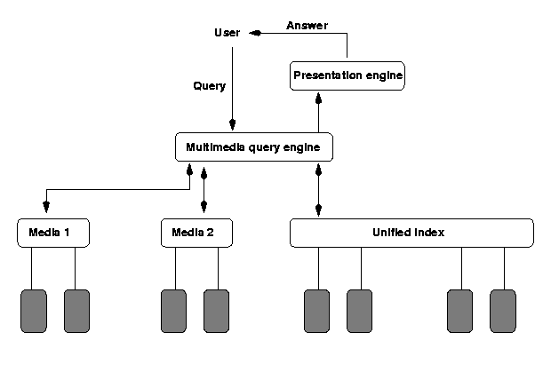
MM Database Architectures (cont.)
Based on Principle of Hybrid Organization
A hybrid of the first two. Certain media types use their own indexes, while others use the "unified" index
An attempt to capture
the advantages of the
first two
Joins across multiple
data sources using their
native indexes

Slide 16
Organizing Multimedia Data Based on the Principle of Uniformity
Consider the following statements about media data and they may be made by a human or may be produced by the output of an image/video/text content retrieval engine.
The image photol.gif shows Jane Shady, “Big Spender” and an unidentified third person, in Sheung Shui. The picture was taken on January 5, 1997.
The video-clip videol.mpg shows Jane Shady giving “Big Spender” a briefcase (in frames 50-100). The video was obtained from surveillance set up at Big Spender’s house in Kowloon Tong, in October, 1996.
The document bigspender.txt contains background information on Big Spender, a police’s file.

Slide 17
Metadata and Media Abstraction
All these statements are Meta-data statements.
Associate, with each media object o_{i}, some meta-data, md(o_{i})
If our archive contains objects o₁,..., o_{n}, then index the meta data md(o₁),..., md(o_{n}) in a way that provides efficient ways of implementing the expected accesses that users will make.
We expect to take use of a single data structure to represent metadata
This can be achieved via media abstractions
Media abstractions are mathematical structure representing such media content.

Slide 18
Querying SMDSs (Uniform Representation)
Querying SMDS based on top of SQL. Basic functions include:
FindType(Obj): This function takes a media object Obj as input, and returns the output type of the object. For example,
FindType(iml.gif) = gif.
FindType(moviel.mpg) = mpg.
FindObjWithFeature(f): This function takes a feature f as input and returns as output, the set of all media objects that contain that feature. For example,
FindObjWithFeature(john)= {iml.gif,im2.gif,im3.gif,videol.mpg:[1,5]}. FindObjWithFeature(mary)= {videol.mpg:[1,5],videol.mpg:[15,50]}.

Slide 19
Querying SMDSs (Uniform Representation) (cont.)
FindObjWithFeatureandAttr(f,a,v): This function takes as input, a feature f, an attribute name a associated with that feature, and a value v. It returns as output, all objects obj that contain the feature and such the value of the attribute a in object obj is v. E.g.
FindObjWithFeatureandAttr(Big Spender,suit,blue): This query asks to find all media objects in which Big Spender appears in a blue suit.
FindFeaturesinObj(Obj): This query asks to find all features that occur within a given media object. It returns as output, the set of all such features. For example,
FindFeaturesinObj (iml.gif): This asks for all features within the image file iml.gif. It may return as output, the objects John, and Lisa.
FindFeaturesinObj(videol.mpg:[1,15]): This asks for all features within the first 15 frames of the video file videol.mpg. The answer may include objects such as Mary and John.

Slide 20
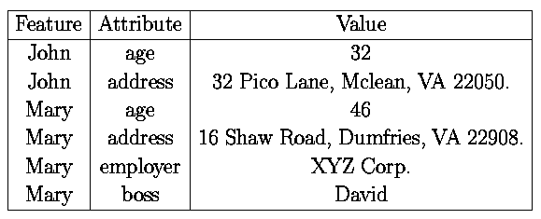
Querying SMDSs (Uniform Representation) (cont.)
FindFeaturesandAttrinObj(Obj): This query is exactly like the previous query except that it returns as output, a relation having the scheme
(Feature,Attribute,Value)
where the triple (f,a,v) occurs in the output relation iff feature f occurs in the query FindFeaturesinObj(Obj) and feature f's attribute a is defined and has value v. For example,
FindFeaturesandAttrinObj(iml.gif) may return as answer, the table

Slide 21
Querying SMDS by SMDS-SQL
All ordinary SQL statements are SMDS-SQL statements. In addition:
The SELECT statement may contain media-entities. A media entity is defined as follows:
If m is a continuous media object, and i, j are integers, then m:[i, j] is a media-entity denoting the set of all frames of media object m that lie between (and inclusive of) segments i, j.
If m is not a continuous media object, them m is a media entity.
If m is a media entity, and a is an attribute of m, then m.a is a media-entity.
The FROM statement may contain entries of the form
<media> <source> <M>
which says that only media-objects associate with the named media type and named data source are to be considered when processing the query, and that M is a variable ranging over such media objects.

Slide 22
Querying SMDS by SMDS-SQL (cont)
The WHERE statement allows (in addition to standard SQL constructs), expressions of the form
term IN func_ca11
where
term is either a variable (in which case it ranges over the output type of func_call) or an object having the same output type as func_call and
func_call is any of the five function calls stated above

Slide 23
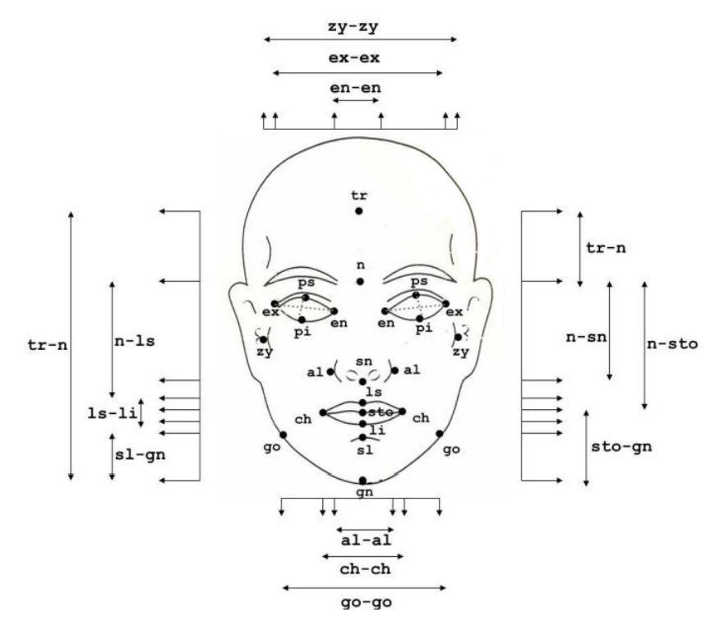
Image Wajah

Slide 24
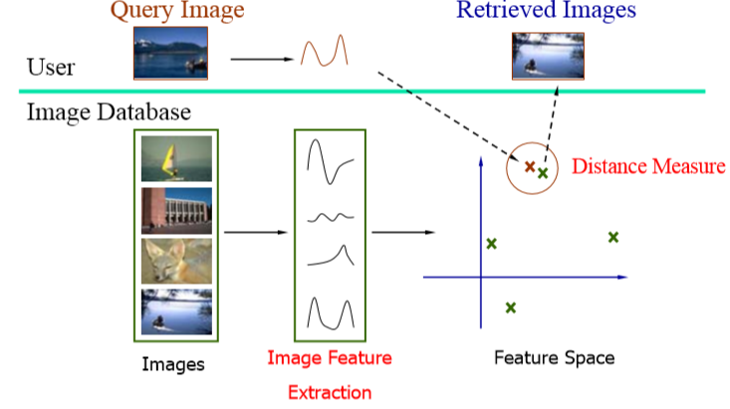
Metode yang dapat digunakan:
STATISTIK
Distance measure/image feature

Slide 25
Methode yang dapat digunakan:
2. SINTAKTIK
Berdasarkan Grammar/Structure/Literal Strings
3. SEMANTIK
Berdasarkan Makna Object

Slide 26
Perbedaan Statistik dan Sintaktik
Pattern Recognition
Based on Statistic Method | Based on Syntactic Method
Feature space on n points is extracted (using transform) | Grammar is defined to describe structure of pattern
Each pattern is the treated as point in n-dimension features space | Using formulated parser
Classification is by minimum distance/nearest neighbor | Input data in often preprocessed in to form of literal strings
Perform well given transform which gives well clustered featured space | Primitive (simple component) in pattern are replace by literals
Become difficult if feature space does not cluster well | Can recognize highly structured and complex patterns for which there is no suitable statistical recognition method
Fail if usable transform cannot be found | Grammar and recognizer can be complex
Tend to be unsuitable for highly structured pattern

Slide 27
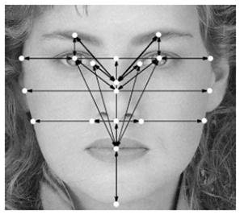
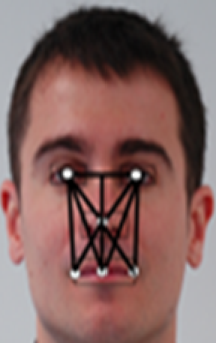
Region of interest (ROI)
WHERE IS THE BEST?
TRADE OFF ROI, UNTUK MENGHINDARI KUTUKAN DIMENSI

Slide 28
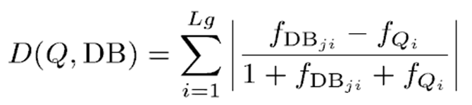
Query Matching
Fitur vektor untuk citra query direpresentasikan sebagai F_{Q} = (F_{Q1}, F_{QN} , ….) yang diperoleh dari ekstraksi fitur.
Demikian pula, setiap gambar dalam database diwakili dengan vektor fitur, dipresentasikan dengan: F_{db} = (F_{DBj1} , F_{DBjn} , ….)
Tujuannya adalah untuk memilih gambar terbaik yang menyerupai citra query. Hal ini melibatkan pemilihan gambar cocok terbaik dengan mengukur/membandingkan jarak antara citra query dan image wajah dalam basis data. Untuk menghitung tingkat kemiripan digunakan similarity distance metric dengan persamaan sebagai berikut:
J= 1,2….|DB| dan FDB = i th feature dari j th image wajah dalam database

Slide 29
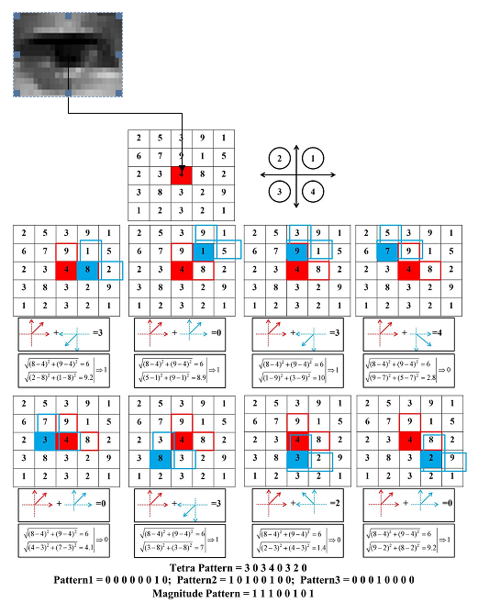
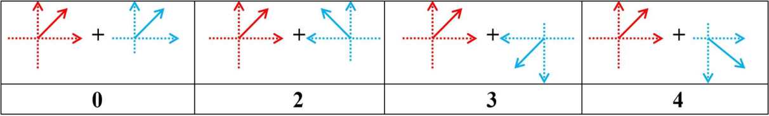
Local Tetra Pattern (contoh pendekatan statistik)

Slide 30
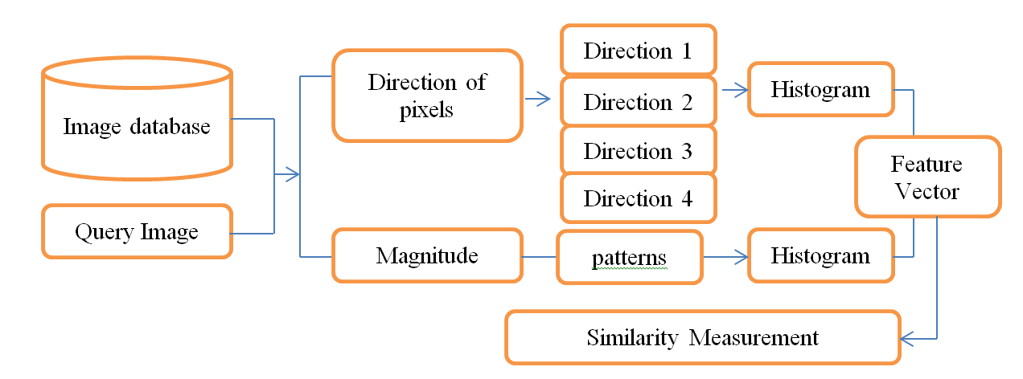
Frame work Local Tetra Pattern

Slide 31
Data awal
Data (Pembobotan):
Static (step 1): impresi-impresi wajah yang sama, memiliki variasi perbedaan sangat kecil → False Match Rate(FMR) > 0
Dynamic (step 2): impresi-impresi wajah yang tidak sama, memiliki variasi perbedaan sangat besar → False Not Match Rate (FNMR) > 0.

Slide 32
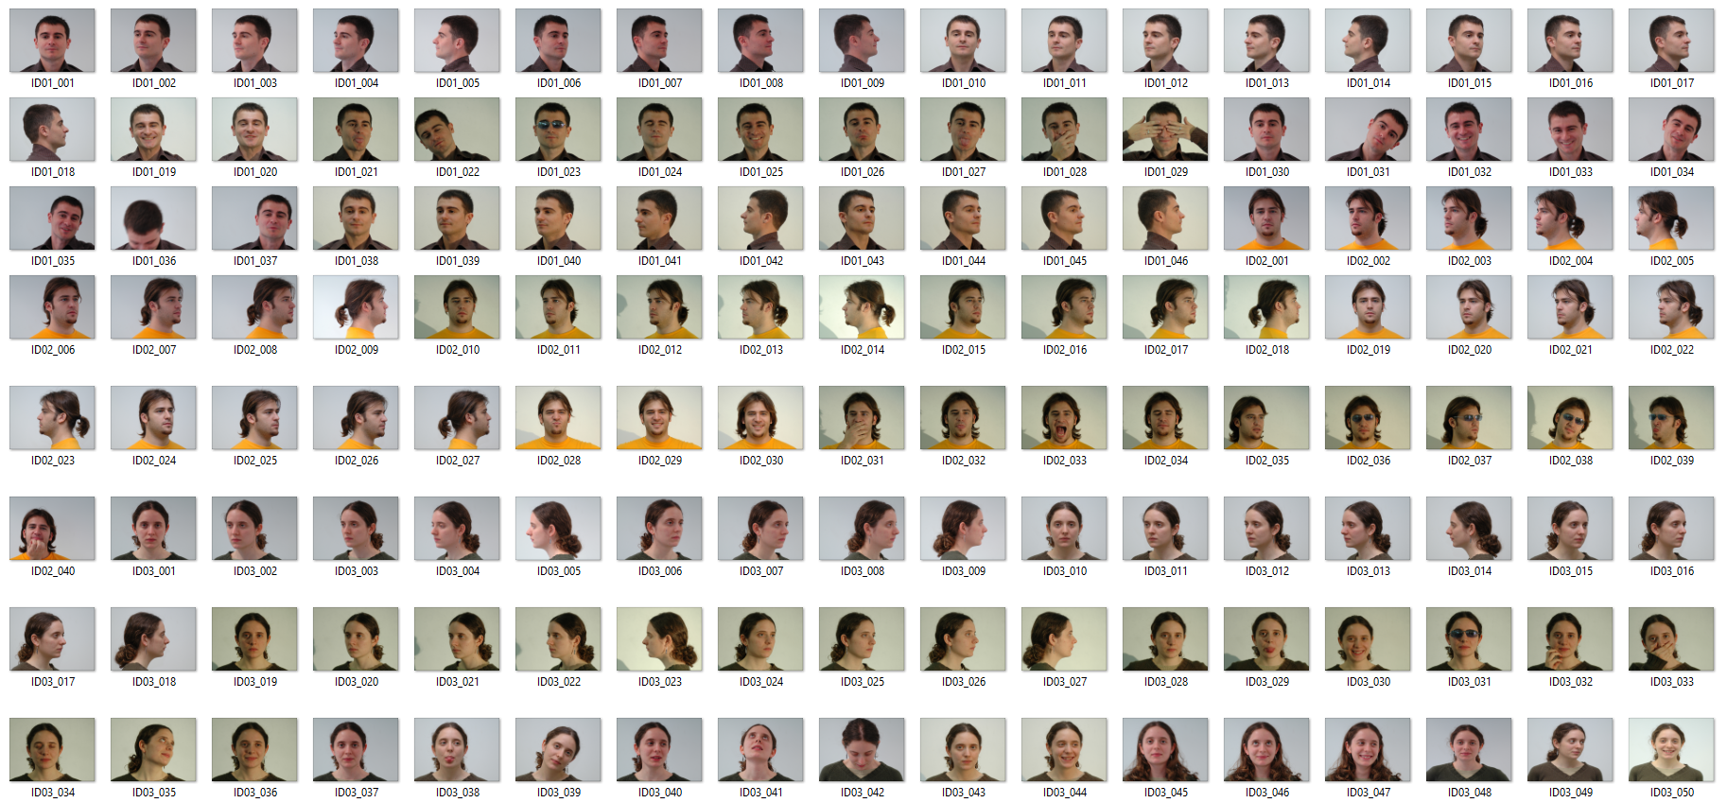
Data Set

Slide 33
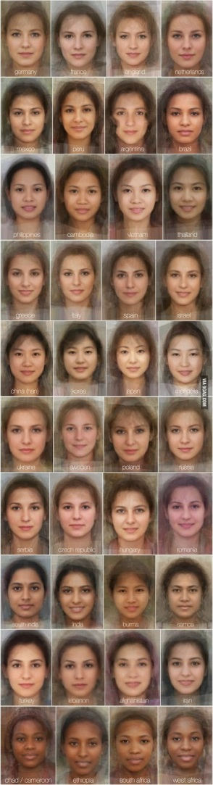
TERLALU MIRIP…..?

Slide 34
Definisi Feature / Ciri / Object Deskriptor
Feature atau ciri (fitur) merupakan suatu deskriptor yang menggambarkan karakteristik dari obyek.
Kita akan mempelajari regional descriptor.
Kemudian akan dilanjutkan dengan ciri ciri tekstur.

Slide 35
Beberapa Regional Descriptors
Area of a region: dinyatakan dengan jumlah piksel yang ada pada wilayah tersebut.
Perimeter of a region: dinyatakan dengan panjang (jumlah piksel yang ada pada) garis batas wilayah tersebut.
Region compactness descriptor: dinyatakan dengan perimeter² / area.
Region spread: dinyatakan dengan eigen values.
Region spread descriptor: dinyatakan dengan ratio antara largest eigen value / smallest eigen value

Slide 36
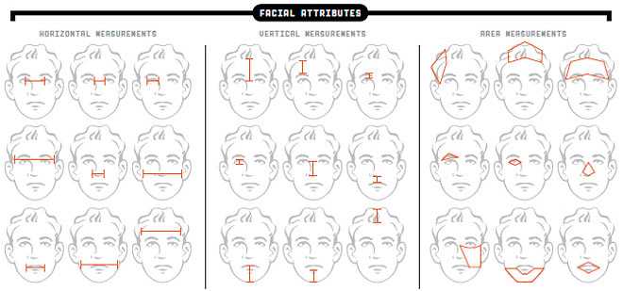

Slide 37
Syntactic Method
Berdasarkan pendekatan sintaktik, wajah manusia dapat difungsikan sebagai fungsi grammar dengan membagi image wajah manusia menjadi beberapa layer geometrik :
Layer satu: Wajah secara keseluruhan (sebagai Sentence)
Layer dua (sebagai Word): Wajah terbagi menjadi beberapa komponen unique wajah (Region of Interest/ROI) meliputi:
Mata, Hidung, Mulut + (Alis Mata, Bibir, …)
Layer tiga (sebagai Letter): Informasi Pixel yang terkandung di ROI secara geometrik

Slide 38
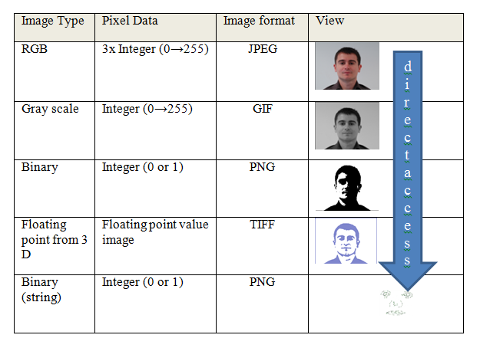
(Ekstraksi Object)

Slide 39
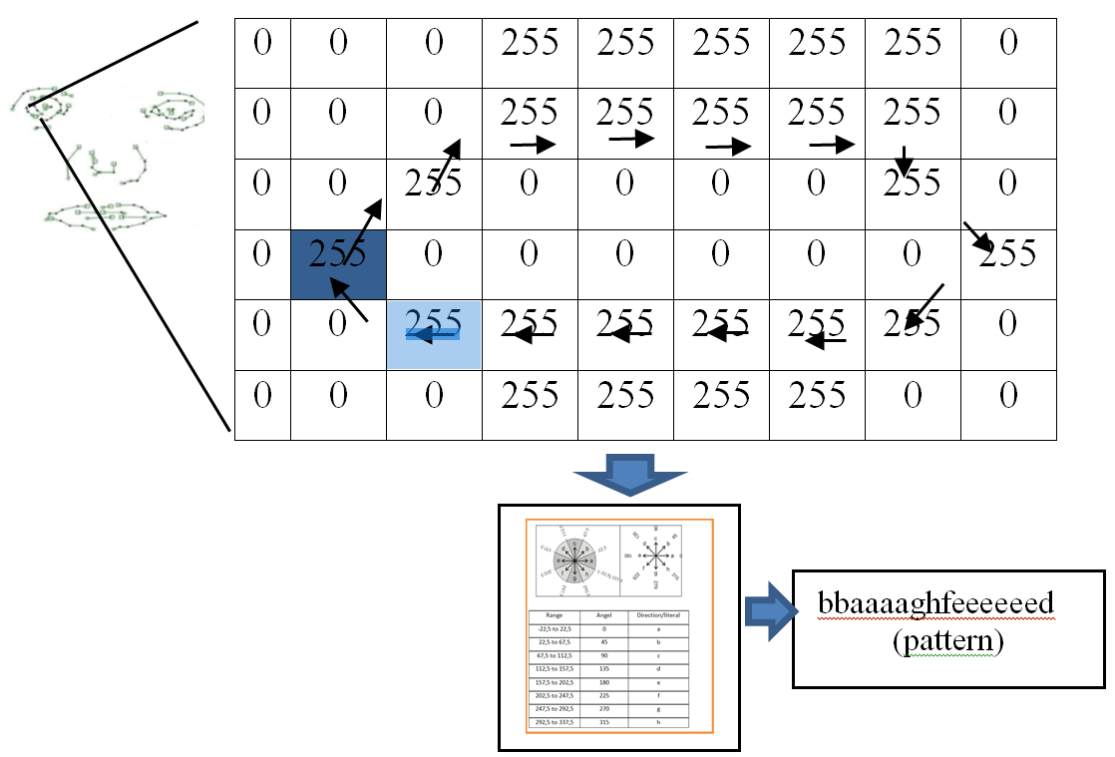
Syntactic (contoh)

Slide 40
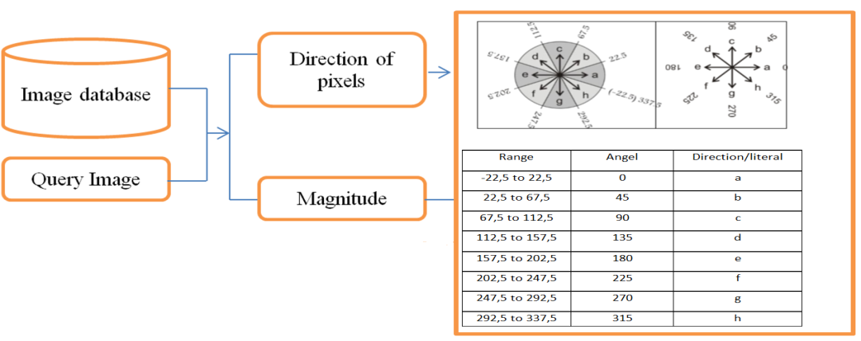
Pattern Octal chain code

Slide 41
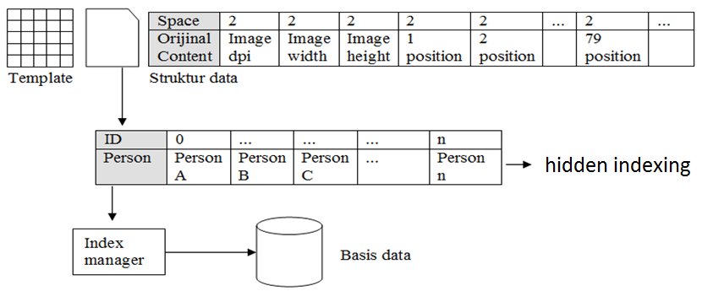
Akses ke Basis Data

Slide 42


Tantangan Pendekatan berbasis Konten
Adanya Gap antara fitur tingkat rendah dan pemahaman semantik user tingkat tinggi
Apa Mau dicari?

Slide 43
Image Retrieval
Pendekatan berbasis konten:
Query mendefinisikan fitur / konten citra
Query by Example
Sistem mengekstrak fitur citra pada query untuk dibandingkan dengan database
Ekstraksi/seleksi Fitur
Indexing
Desain Sistem IR

Slide 44
Fasilitasi
Oracle
MySQL
etc
-fasilitas indexing folder
-java object serialization
-blob

Slide 45
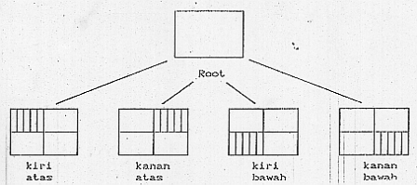
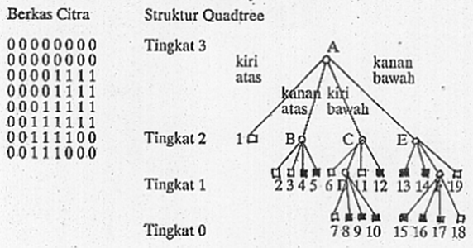
Representasi - Quadtree
Quadtree data structure:
Representasi Quadtree:

Slide 46
DEMO PROGRAM………..

